Slide 1
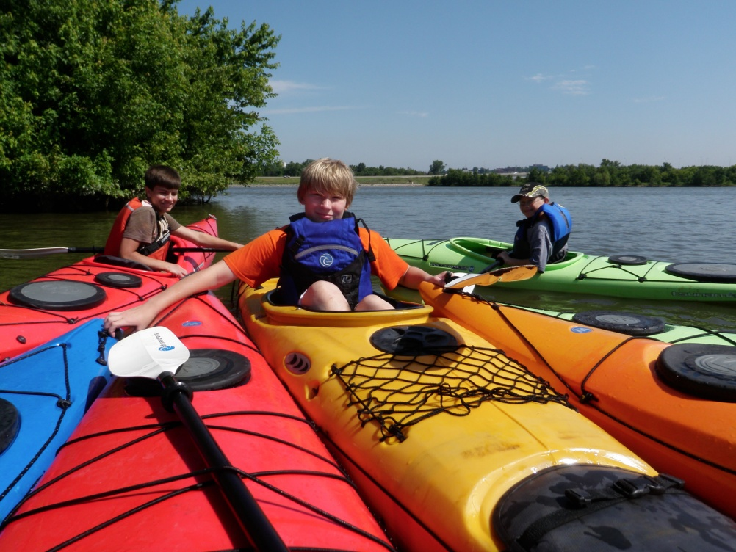
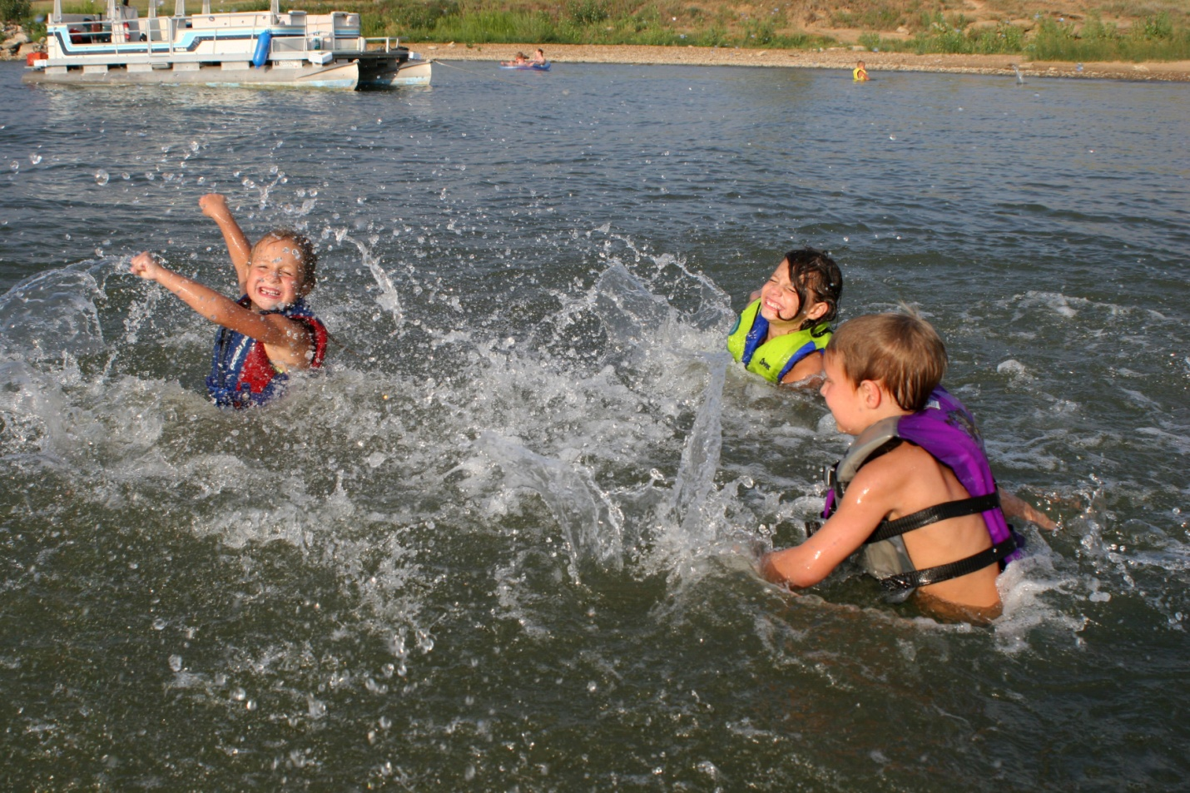
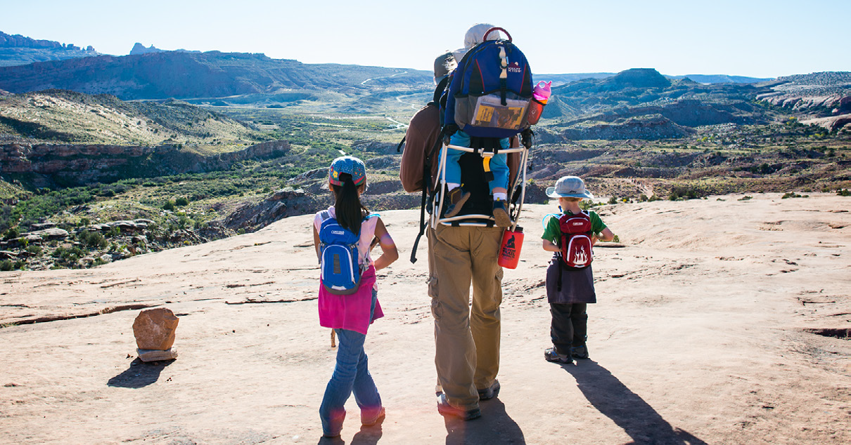
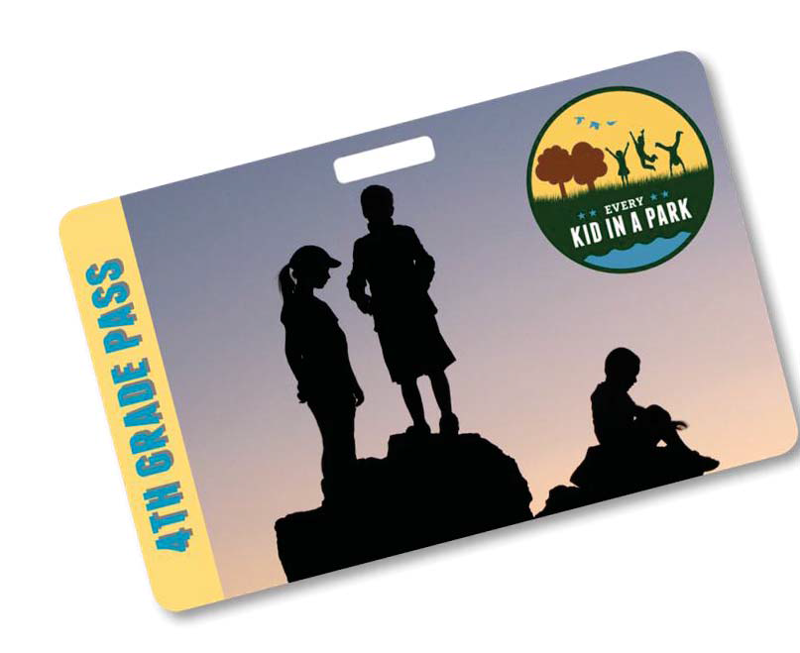
Calling all 4th Graders!
Beginning September 1, 2015, if you are a US 4th grader (including home-schooled and free-choice learners 10 years of age) you can download your own voucher to gain unlimited, FREE access to any federal lands or waters for a year!
A world of learning, discovery, and fun awaits every kid!
You can find America’s federal lands and waters almost everywhere! From Puerto Rico to Maine, and Virginia to the Pacific Islands, some of America’s most spectacular destinations await your discovery.
Learn about your heritage and connect with nature while you explore more than 400 Corps lakes and millions of acres of other federal lands and waters.
Listen to howling wolves, check out prehistoric dinosaur tracks, paddle a river, walk in the footsteps of Lewis and Clark, or look up into a dark night sky and reach for the stars!
Free Access to Federal Lands and Waters for 4th Graders and Their Guests
www.everykidinapark.com

